Slide 1
Module 7
Organizational Buying Behaviour
By: Dr Shahinaz Abdellatif

Slide 2
Objectives of the Session
To distinguish between consumer versus organisational markets and their buying behaviour
To understand organisational markets and their buying behaviour

Slide 3
Differences Between Organizational and Consumer Markets
Demand characteristics
The demand for industrial goods and services is
Derived from the demand for consumer goods and services.
Relatively inelastic—price changes in the short run are not likely to affect demand drastically.
More erratic because small increases or decreases in consumer demand can, over time, strongly affect the demand for manufacturing plants and equipment.
4. More cyclical.

Slide 4
Differences Between Organizational and Consumer Markets
Market demographics
Organizational buyers, when compared with buyers of consumer goods, are:
Few in number
Larger
Geographically concentrated

Slide 5
Differences Between Organizational and Consumer Markets
Buyer-seller relationships
Organizational markets are characterized by:
Use of professional buying specialists following prescribed procedures
Closer buyer—seller relationships (RM)
Presence of multiple buying influences
More apt to buy on specifications

Slide 6
Organizational Centre
For routine purchases a single buyer or purchasing manager may make the purchase decision. For most high-value organisational purchases, several people from different departments participate in the decision process.
The individuals in this group, called a buying centre, share knowledge and information relevant to the purchase of a particular product.
Different members of the buying centre may participate – and exert different amounts of influence – at different stages in the decision process.

Slide 7
Participants in the Organisational Purchasing Process
Users: The people in the organisation who must use or work with the product or service often have some influence on the purchase decision.
Influencers: Influencers provide information for evaluating alternative products and suppliers. They are usually technical experts from various departments within the organisation. Influencers help determine which specifications and criteria to use in making the purchase decision.
Gatekeepers: Gatekeepers control the flow of information to other people in the purchasing process. They primarily include the organisation’s purchasing agents and the suppliers’ salespeople. Gatekeepers influence a purchase by controlling the information that reaches other decision makers.

Slide 8
Participants in the Organisational Purchasing Process
Buyers: The buyer is usually referred to as a purchasing agent or purchasing manager. In most organisations, buyers have the authority to contact suppliers and negotiate the purchase transaction. In some cases they exercise wide discretion in carrying out their jobs. In other cases, they are tightly constrained by specifications and contract requirements determined by technical experts and top administrators.
5. Deciders: The decider is the person with the authority to make a final purchase decision. Sometimes buyers have this authority, but often lower-level purchasing managers carry out the wishes of more powerful decision makers.

Slide 9
Organisational Buying Situations
A straight rebuy involves purchasing a common product organisation has bought many times before. Such purchases are often handled routinely by the purchasing department with little participation by other departments. Such purchases are almost automatic, short and routine.
A modified rebuy occurs when the organisation’s needs remain unchanged, but buying centre members are not satisfied with the product or the supplier they have been using. They may desire a higher-quality product, a better price, or better service. Here buyers need information about alternative products and suppliers to compare .
New-task buying occurs when an organisation faces a new and unique need or problem – one in which buying centre members have little or no experience and, thus, must expend a great deal of effort to define purchasing specifications and to collect information about alternative products and vendors.

Slide 10
Marketing Implications of New task purchases
In new-task purchases an organisation is buying a relatively complex product or service for the first time. Buyers in such circumstances tend to collect a lot of information about alternative products and suppliers and to engage in extensive comparisons before making a final purchase decision.
Such situations are relatively favourable to potential new suppliers who have never sold to the organisation. Such newcomers can win the organisation’s business if they can provide superior product benefits, superior customer service, or better prices (i.e. better customer value) band if they can convince the customer of their superiority through an effective sales pitch, a user-friendly website, or promotional efforts.
One major reason for establishing long-term cooperative relationships with major customers is to become an active partner in designing – and setting the specifications for the customer’s products (i.e purchase criteria).

Slide 11
The Marketing Implications Straight Rebuy Purchases
In a straight rebuy the customer is reordering an item it has purchased many times before. These purchases tend to be more routine and computerised.
From the seller’s viewpoint, being the established or ‘in’ supplier in such purchase situations provides a major competitive advantage because the customer spends little or no effort evaluating alternatives.
Therefore, established suppliers should develop procedures to maintain and enhance their favoured position with current customers (such as ‘key account’ policies and appoint cross-functional teams to service major customers to help ensure their satisfaction and retention, supply chain management systems and logistical alliances).

Slide 12
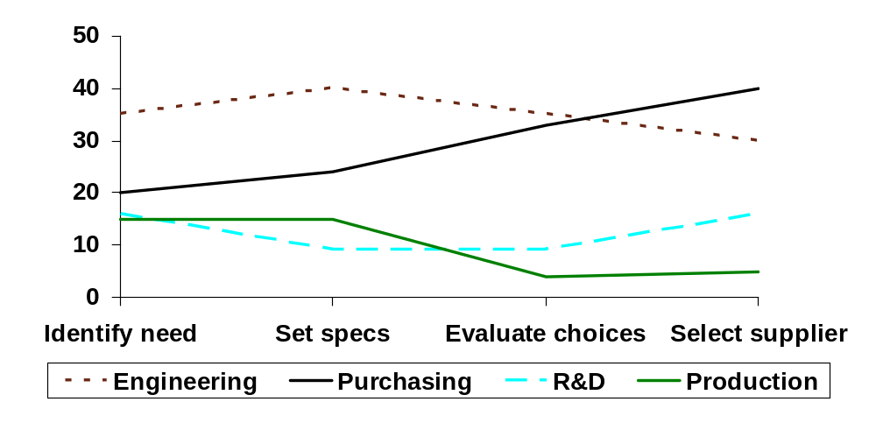
The Relative Influence of Various Functional
Departments at Different Stages in New Buy
Organizational Purchasing Decisions
New buy
Relative influence
Purchase stages
Source: Based on E. Naumann, D. J. Lincoln, and R. D. McWilliams, “The Purchase of Components: Functional Areas of Influence,” Industrial Marketing Management, May 1994, pp. 113-22. Reprinted with permission of the publisher. Copyright © 1984 by Elsevier Science Publishing Co., Inc. See also R. D. McWilliams, E. Naumann,
and S. Scott, “Determining Buying Center Size,” Industrial Marketing Management 21 (February 1992), pp. 43-50.
Notes:
4
What are the implications for sellers of the pattern shown here?
Shows where relatively more or less selling effort should be targeted

Slide 13
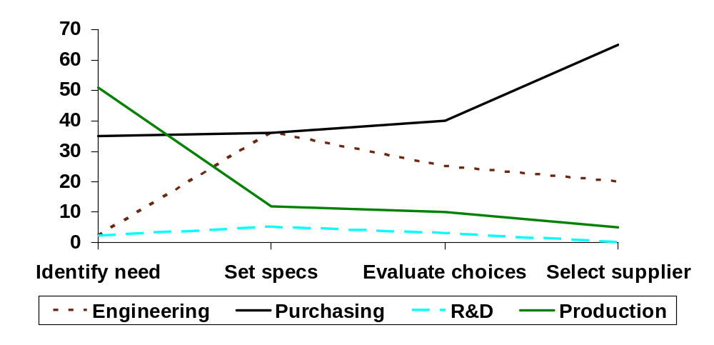
The Relative Influence of Various Functional
Departments at Different Stages in Straight
Rebuy Organizational Purchasing Decisions
Straight rebuy
Relative influence
Purchase stages
Source: Based on E. Naumann, D. J. Lincoln, and R. D. McWilliams, “The Purchase of Components: Functional Areas of Influence,” Industrial Marketing Management, May 1994, pp. 113-22. Reprinted with permission of the publisher. Copyright © 1984 by Elsevier Science Publishing Co., Inc. See also R. D. McWilliams, E. Naumann,
and S. Scott, “Determining Buying Center Size,” Industrial Marketing Management 21 (February 1992), pp. 43-50.
Notes:
5
What are the implications for sellers of the pattern shown here?
Shows where relatively more or less selling effort should be targeted

Slide 14
The Organizational Decision-Making
Process for New-Task Purchases
Recognition of a problem or need
Derived demand
Determining product specifications
Requirement planning
Search for information about products and suppliers
Value analysis
Information about potential suppliers
Make-or-buy decisions
Evaluation and selection of suppliers
Vendor analysis
Purchase decision
Vendor analysis
Postpurchase evaluation and feedback
Notes:
6
Which of the steps in this process can marketing influence?
All of them! (Discuss)

Slide 15
Marketing implications of goods and services bought by organisations
See Exhibit 7.7

